Slide 1
Victorian Square Creative Placemaking Plan
Overview: May 2020
City Council Presentation

Slide 2
How did this all start?
Victorian Square Creative
Placemaking Plan

Slide 3
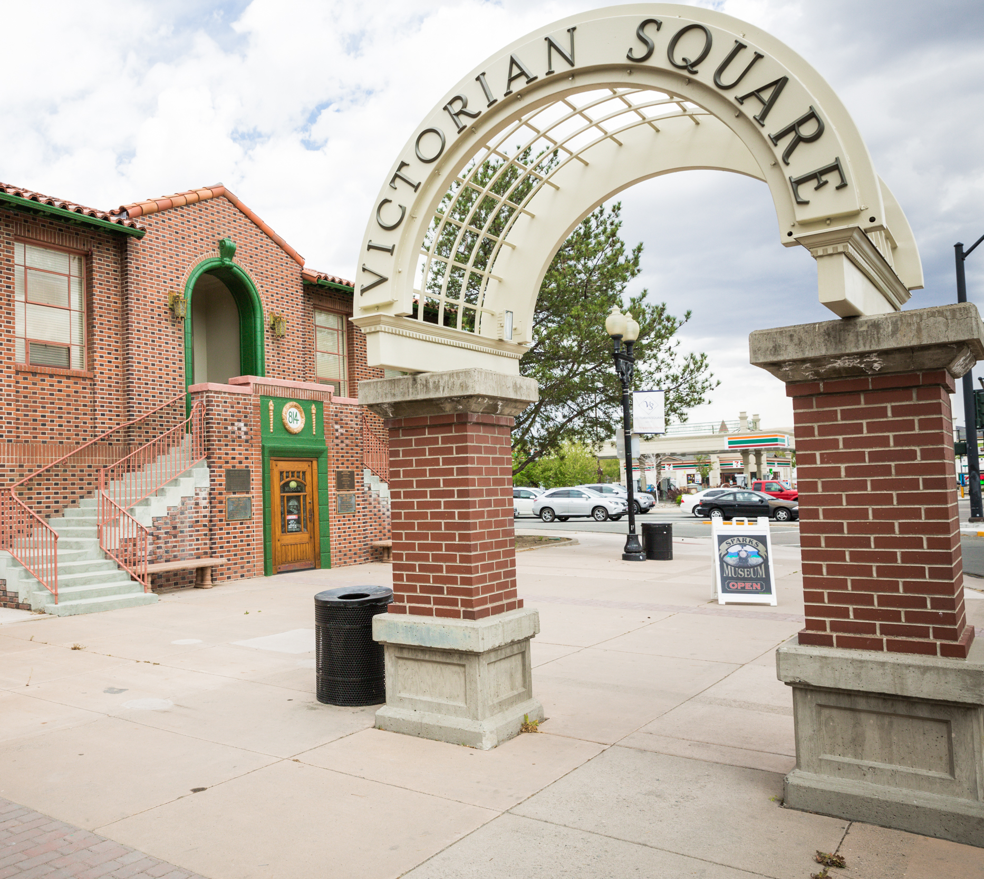
2016 Funding from the Tourism and Facility Revitalization Committee for art in downtown 2018 Awarded A National Endowment for the Arts “Our Town” Grant 2018-19 Together We See Sparks Project
Victorian Square Creative
Placemaking Plan

Slide 4
What was Together, We See Sparks?
Victorian Square Creative
Placemaking Plan

Slide 5
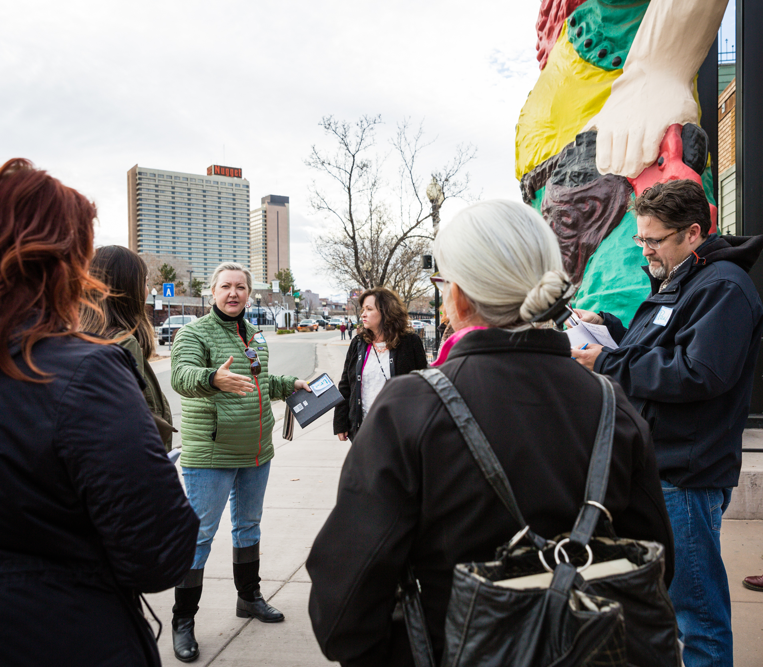
1. Assembled a committee of 12 stakeholders 2. Conducted a full survey (and mini ones) 3.Worked with consultants that held trainings and met with stakeholders. 4. Worked with artists to employ public engagement 5. Developed a plan for VS
Victorian Square Creative
Placemaking Plan

Slide 6
What’s in the plan?
Victorian Square Creative
Placemaking Plan

Slide 7
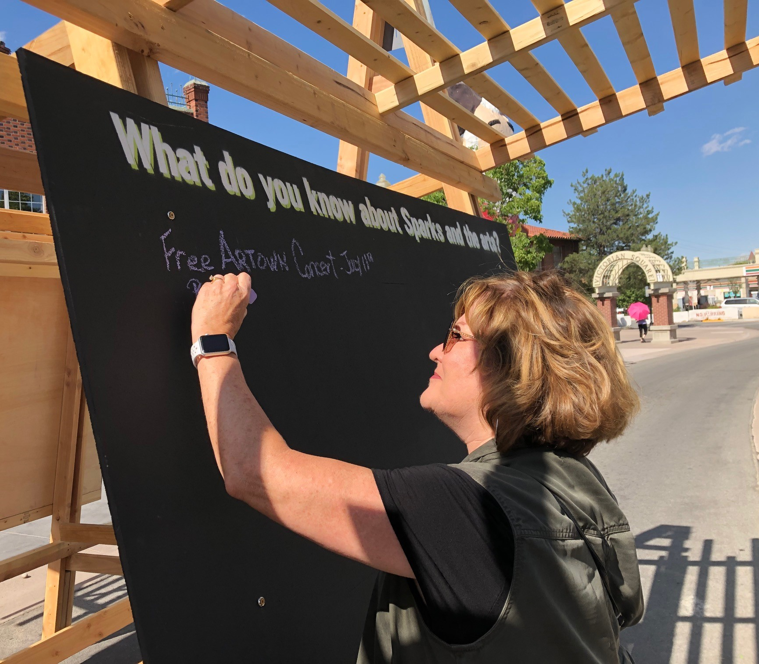
Major elements of the plan include: • Description of Victorian Square • Development challenges • What art should accomplish • Recommendations • Artist selection process Entire plan is here: CityofSparks.us/together
Victorian Square Creative
Placemaking Plan

Slide 8
Recommendations: Short Term
Victorian Square Creative
Placemaking Plan

Slide 9
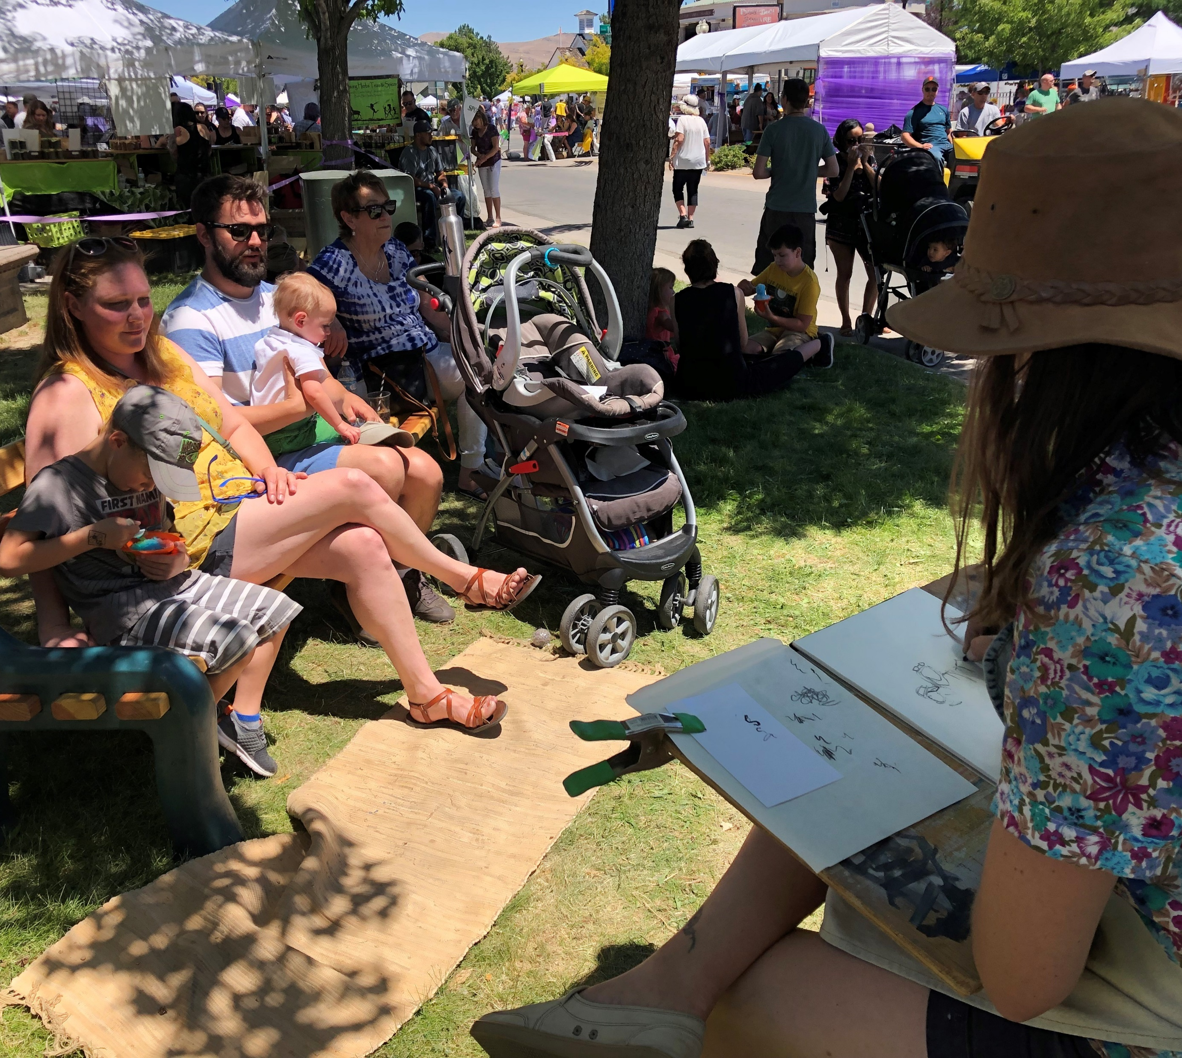
1. Produce a temporary public art program in Victorian Square 2. Commission a permanent work of public art 3. Establish a public art program and establish public art policy and procedures 4. ACAC to implement the master plan 5. Make recommendations on plans that affect festivals
Victorian Square Creative
Placemaking Plan

Slide 10
Recommendations: Long Term
Victorian Square Creative
Placemaking Plan

Slide 11
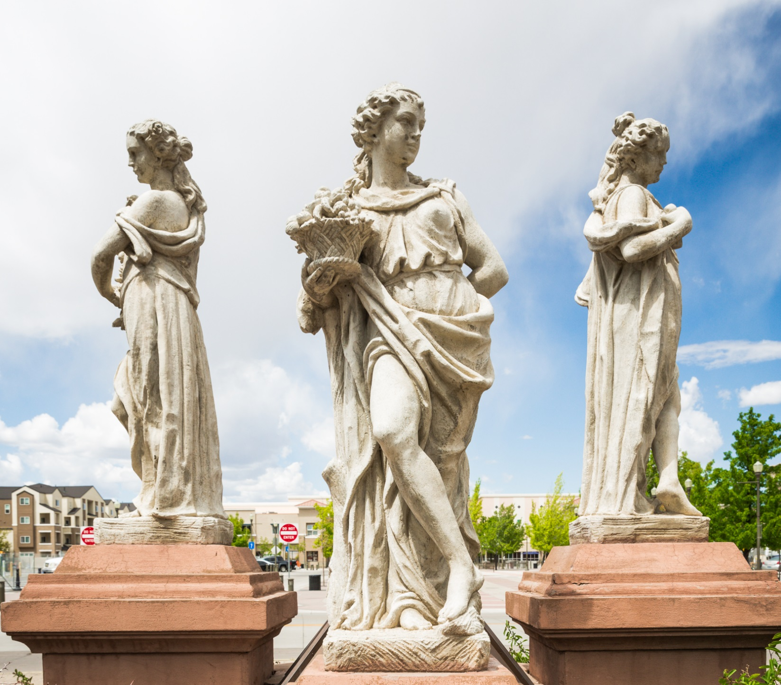
1. Develop temporary public art programming 2. Create an artist/designer-in-residence program 3. Create gathering places for people 4. Reinforce Victorian Square with branding and signage 4. Create opportunities for community education 5. Decommission the artwork commonly referred to as the “Four Seasons”
Victorian Square Creative
Placemaking Plan

Slide 12
Embracing the future
Victorian Square Creative
Placemaking Plan

Slide 13
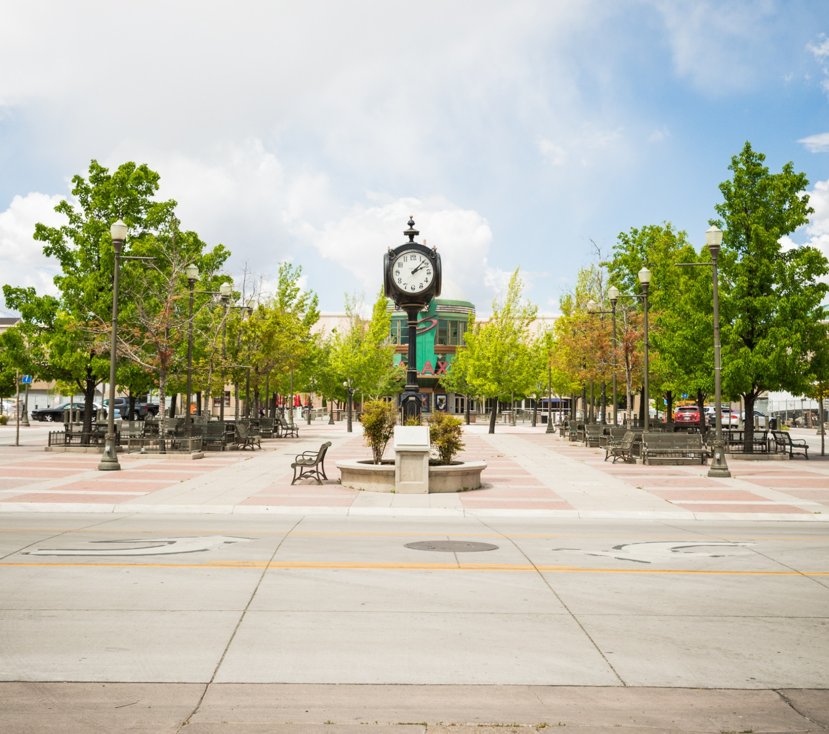
How would you like to participate?
Victorian Square Creative
Placemaking Plan

Slide 14
Special Thanks
TWSS Committee
Francine Burge, City of Sparks, Project Lead Lisa Bonie, Northern Nevada Center for Independent Living Charlene Bybee, City of Sparks City Council Kim Ciesynski, Spaces Design & Planning/39 North Tina Drakulich, DJD Foundation Paul Fenkell, Artist Angela Handler, LoKa Tile Group/39 North Cheryl Hare, Community Leader Randy Kennedy, Nugget Casino Resort Grace Larkins, Graphic Designer Ashley Robison, Photographer Andrea Tavener, Washoe County Library System Shoshana Zeldner, UNR
Victorian Square Creative
Placemaking Plan

Slide 15
Special Thanks
Inkind Support from
Nugget Casino Resort
Rita P. Best, Web Designer
Grace Larkins, Lark Designs
JAX Communications
Great Basin Brewery Company
Victorian Square Creative
Placemaking Plan

